Slide 1
10 FOUR SOLUTIONS
PRE-QUALIFICATION DOCUMENTS
INDEX :
COMPANY INFORMATION
OUR EXPERTISE
PROJECTS
OUR LOCATIONS
www.10four.org
Firm Portfolio|1

Slide 2
10FOUR Solutions is a BIM Professional Services Company with subject matter experts based in USA, Middle- east & India providing Architectural, Structural & MEP Modelling services.
10FOUR
SOLUTIONS
10FOUR Solutions is based in Maryland, United States with additional offices in India & Middle East and operates with a vision to provide innovative and sustainable solutions to Architects, Structural Consultants & MEP consultants. A Team of over 100 Modellers & Engineers work off-site & on-site to provide exception technical service with a focus on customer satisfaction.
Our organization and professionals of company gained a wide range experience in Architectural, Structural & MEP Modelling on US, UK & Middle East projects.
www.10four.org
Firm Portfolio|2

Slide 3
Our expertise
REVIT
CAD TO BIM MODELLING SERVICES
HAND SKETCHES TO BIM MODELLING SERVICES
2D DOCUMENTATION SERVICES
BIM 4D SERVICES
ANIMATION & VISUALISATION SERVICES
BIM FACILITY MANAGEMENT SERVICES
MEP DESIGN SERVICES
2. SCAN TO BIM MODELLING SERVICES
3. GIS
4. BIM RESOURCE MANAGEMENT
10 FOUR expertise lay in hiring of talented, Modellers, outstanding experts and passionate partners. We encourage our people to bring out their marvels and valuable ideas, we encourage our architects and engineers to work together combining their knowledge from different disciplines practicing modelling at a high level of quality.
10 FOUR offers progressive architectural, structural and mep modelling from concept design through to detail design and construction plans.
www.10four.org
Firm Portfolio|3

Slide 4
BUILDINGS
www.10four.org
Firm Portfolio|4

Slide 5
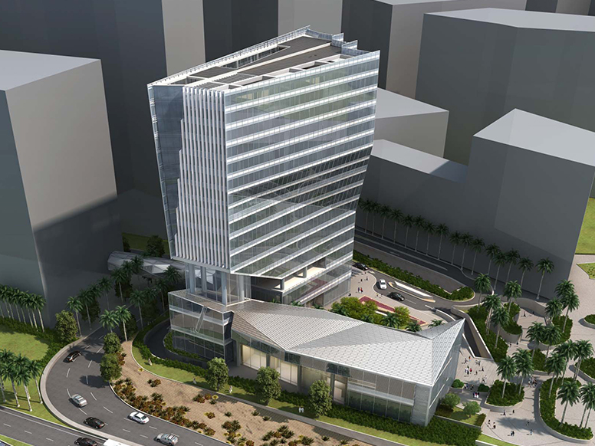
CAD TO BIM MODELLING SERVICES
REVIT
CAD TO BIM MODELLING SERVICES
HAND SKETCHES TO BIM MODELLING SERVICES
2D DOCUMENTATION SERVICES
BIM 4D SERVICES
ANIMATION & VISUALISATION SERVICES
BIM FACILITY MANAGEMENT SERVICES
MEP DESIGN SERVICES
2. SCAN TO BIM MODELLING SERVICES
3. GIS
4. BIM RESOURCE MANAGEMENT
Client: TXG – Technical Xperts Group
Project Name: King Abdullah Financial District – Parcel 4.01 Project Type: Residential & Commercial Location: Saudi Arabia LOD: 300 ( Modelling ) & 500 ( Facility Management) Area: 33,000 Sqmts Software’s Used: AutoCAD, Revit, Naviswork, Recap, Diroots & COBIE
Scope of Work: ( Architectural, Structural, MEP Modelling & facility Management)
Client’s final requirement is Facility management, the LOD 300 model developed with the help of CAD files and Scan Data ( LIDAR Scan Data). Complete data was updated as per Asset Register collected from all stack holders. Schedules extracted from Revit and generated 2D As-built drawings.
www.10four.org
Firm Portfolio|5

Slide 6
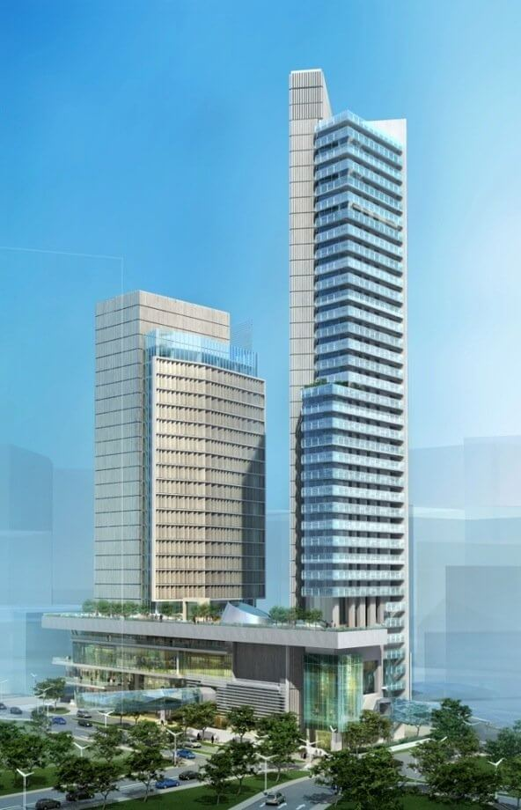
CAD TO BIM MODELLING SERVICES
REVIT
CAD TO BIM MODELLING SERVICES
HAND SKETCHES TO BIM MODELLING SERVICES
2D DOCUMENTATION SERVICES
BIM 4D SERVICES
ANIMATION & VISUALISATION SERVICES
BIM FACILITY MANAGEMENT SERVICES
MEP DESIGN SERVICES
2. SCAN TO BIM MODELLING SERVICES
3. GIS
4. BIM RESOURCE MANAGEMENT
Client: TXG – Technical Xperts Group
Project Name: King Abdullah Financial District – Parcel 5.05 Project Type: Residential & Commercial Location: Saudi Arabia LOD: 300 ( Modelling ) & 500 ( Facility Management) Area: 90,000 Sqmts ( 1st Tower – 25 & 2nd Tower- 34 Floors) Software’s Used: AutoCAD, Revit, Naviswork, Recap, Diroots & COBIE
Scope of Work: ( Architectural, Structural, MEP Modelling & facility Management)
Client’s final requirement is Facility management, the LOD 300 model developed with the help of CAD files and Scan Data ( LIDAR Scan Data). Complete data was updated as per Asset Register collected from all stack holders. Schedules extracted from Revit and generated 2D As-built drawings.
www.10four.org
Firm Portfolio|6

Slide 7
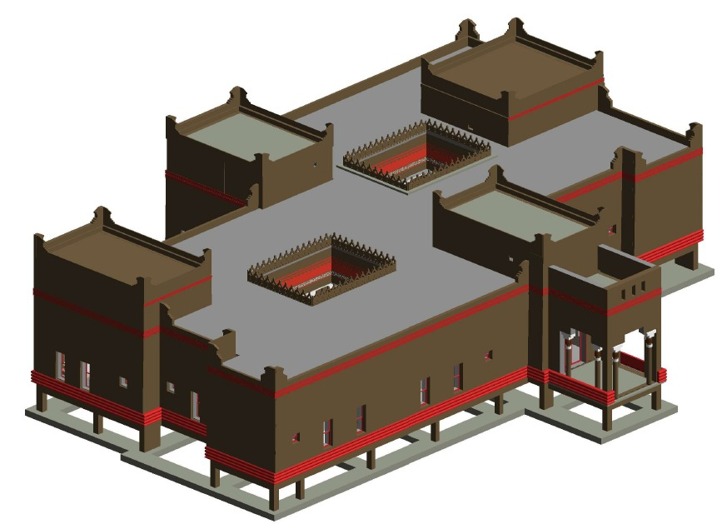
CAD TO BIM MODELLING SERVICES
REVIT
CAD TO BIM MODELLING SERVICES
HAND SKETCHES TO BIM MODELLING SERVICES
2D DOCUMENTATION SERVICES
BIM 4D SERVICES
ANIMATION & VISUALISATION SERVICES
BIM FACILITY MANAGEMENT SERVICES
MEP DESIGN SERVICES
2. SCAN TO BIM MODELLING SERVICES
3. GIS
4. BIM RESOURCE MANAGEMENT
Client: TXG – Technical Xperts Group
Project Name: Al- Dera Farm Luxuries Villas - Riyadh Project Type: Residential Location: Saudi Arabia LOD: 500 Area: 4,200 Sqmts
Software’s Used: AutoCAD, Revit, Naviswork & COBIE
Scope of Work: ( Architectural, Structural, MEP Modelling & facility Management)
LOD 500 model developed with the help of CAD files. Complete data was updated as per Asset Register collected from all stack holders. Schedules extracted from Revit and generated 2D As-built drawings.
www.10four.org
Firm Portfolio|7

Slide 8
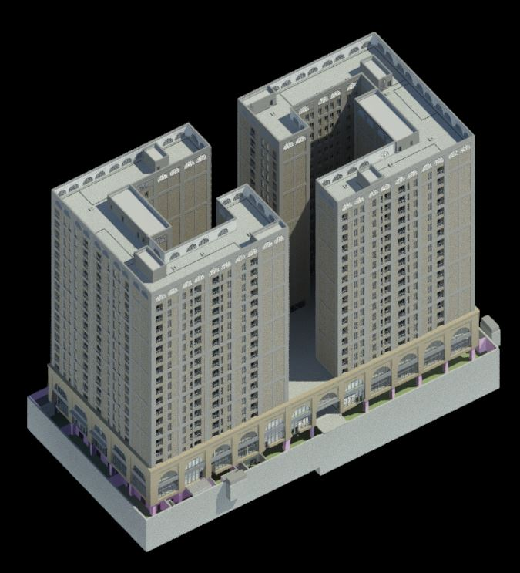
CAD TO BIM MODELLING SERVICES
REVIT
CAD TO BIM MODELLING SERVICES
HAND SKETCHES TO BIM MODELLING SERVICES
2D DOCUMENTATION SERVICES
BIM 4D SERVICES
ANIMATION & VISUALISATION SERVICES
BIM FACILITY MANAGEMENT SERVICES
MEP DESIGN SERVICES
2. SCAN TO BIM MODELLING SERVICES
3. GIS
4. BIM RESOURCE MANAGEMENT
Client: Meinhardt Qatar
Project Name: HAH Residential Buildings Project Type: Residential Location: Qatar LOD: 350 Area: 60,200 Sqmts
Software’s Used: AutoCAD, Revit, Naviswork
Scope of Work: ( Architectural, Structural & MEP Modelling)
LOD 350 model developed with the help of Design CAD files. Schedules extracted from Revit and generated 2D Detail Design drawings.
www.10four.org
Firm Portfolio|8

Slide 9
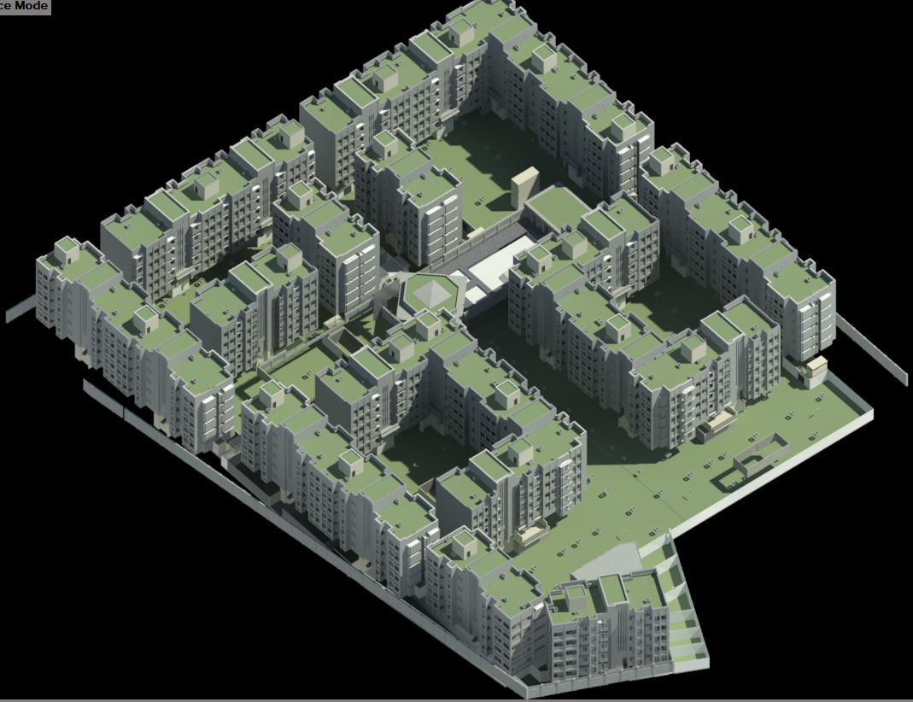
CAD TO BIM MODELLING SERVICES
REVIT
CAD TO BIM MODELLING SERVICES
HAND SKETCHES TO BIM MODELLING SERVICES
2D DOCUMENTATION SERVICES
BIM 4D SERVICES
ANIMATION & VISUALISATION SERVICES
BIM FACILITY MANAGEMENT SERVICES
MEP DESIGN SERVICES
2. SCAN TO BIM MODELLING SERVICES
3. GIS
4. BIM RESOURCE MANAGEMENT
Client: Meinhardt Qatar
Project Name: ARQ Residential Buildings Project Type: Residential Location: Qatar LOD: 350 Area: NA
Software’s Used: AutoCAD, Revit, Naviswork
Scope of Work: ( Architectural & Structural Modelling)
LOD 350 model developed with the help of Design CAD files. Schedules extracted from Revit and generated 2D Detail Design drawings.
www.10four.org
Firm Portfolio|9

Slide 10
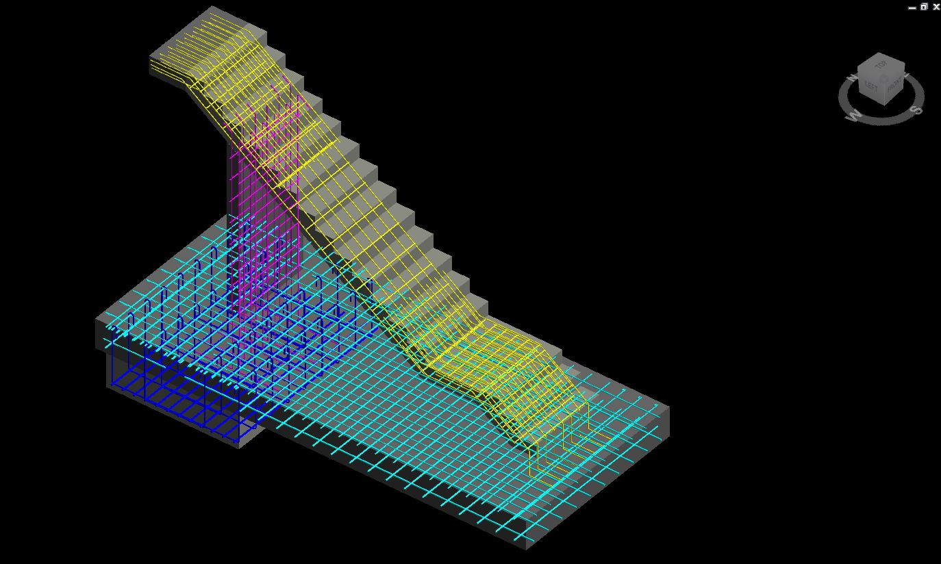
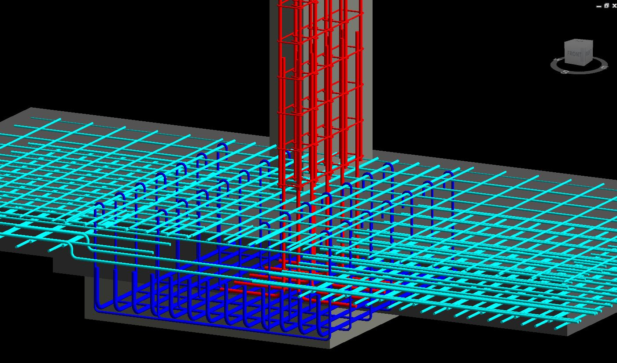
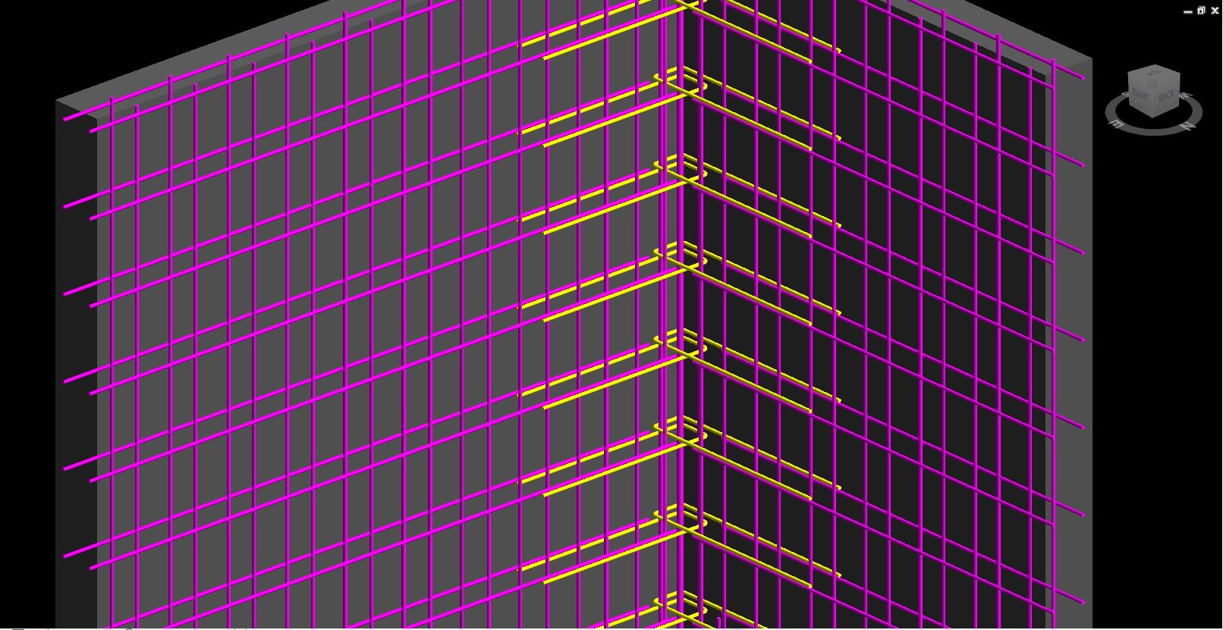
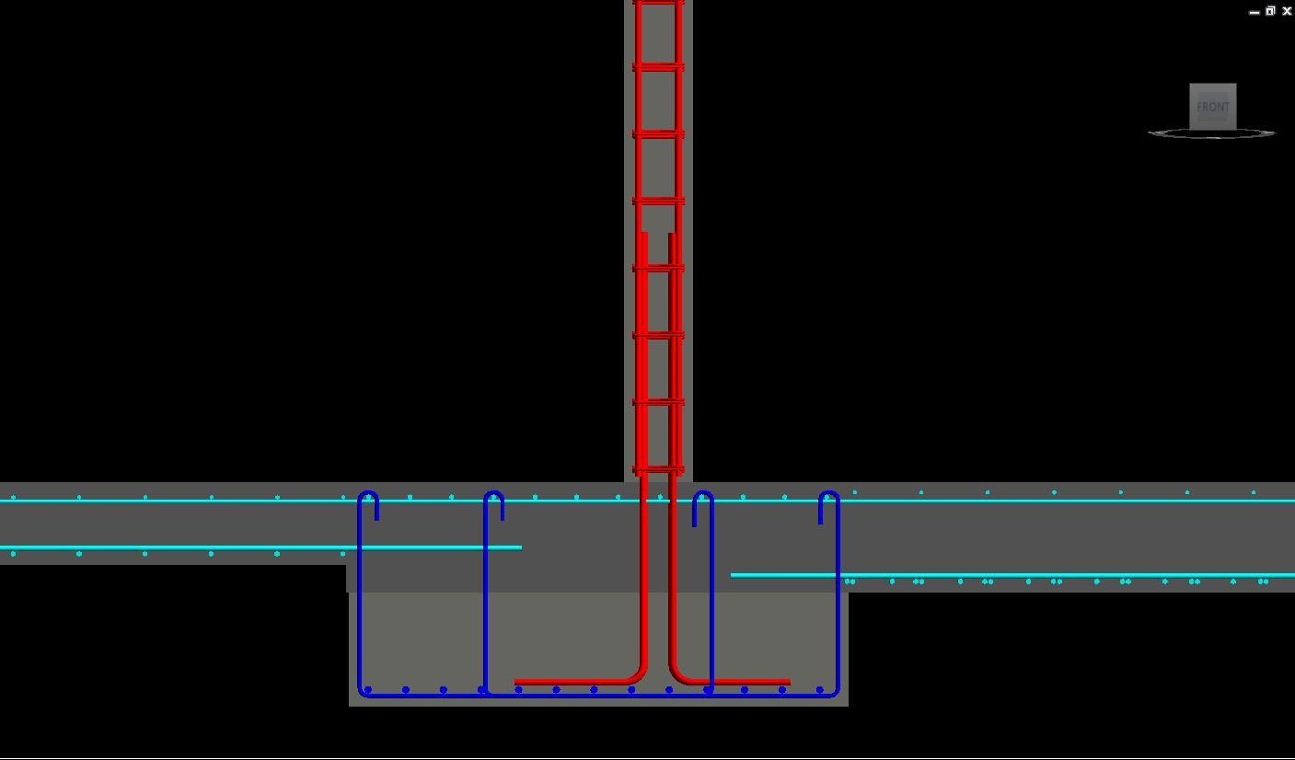
CAD TO BIM MODELLING SERVICES
REVIT
CAD TO BIM MODELLING SERVICES
HAND SKETCHES TO BIM MODELLING SERVICES
2D DOCUMENTATION SERVICES
BIM 4D SERVICES
ANIMATION & VISUALISATION SERVICES
BIM FACILITY MANAGEMENT SERVICES
MEP DESIGN SERVICES
2. SCAN TO BIM MODELLING SERVICES
3. GIS
4. BIM RESOURCE MANAGEMENT
Client: Westra
Project Name: Spring Field Rise Village Project Type: Residential & Commercial Buildings Location: Australia LOD: 350 Area: 33,940 Sqmts
Software’s Used: AutoCAD, Revit, Naviswork
Scope of Work: ( Reinforcement Modelling)
Our scope was RCC modelling of complete buildings following Australian Standards and developed model to LOD 350 with the help of Design CAD files. Schedules extracted from Revit and generated 2D Detail Design drawings.
www.10four.org
Firm Portfolio|10

Slide 11
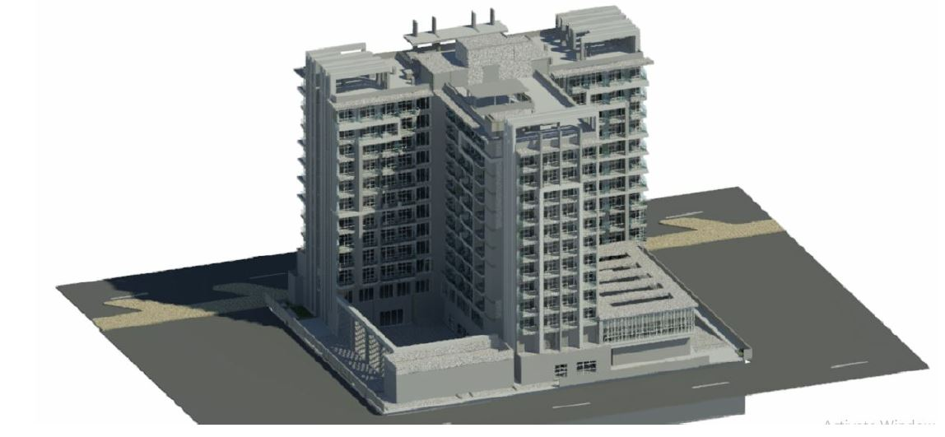
CAD TO BIM MODELLING SERVICES
REVIT
CAD TO BIM MODELLING SERVICES
HAND SKETCHES TO BIM MODELLING SERVICES
2D DOCUMENTATION SERVICES
BIM 4D SERVICES
ANIMATION & VISUALISATION SERVICES
BIM FACILITY MANAGEMENT SERVICES
MEP DESIGN SERVICES
2. SCAN TO BIM MODELLING SERVICES
3. GIS
4. BIM RESOURCE MANAGEMENT
Client: JIANMING WANG & JIAO WEI
Project Name: Al- Furjan Buildings Project Type: Residential & Commercial Location: Sharjah LOD: 350 Area: 69,996 Sqmts
Software’s Used: AutoCAD, Revit, Naviswork
Scope of Work: ( Architectural & Structural Modelling)
Initially LOD 300 model and later developed to LOD 350 with the help of Design CAD files. Schedules extracted from Revit and generated 2D Detail Design drawings.
www.10four.org
Firm Portfolio|11

Slide 12
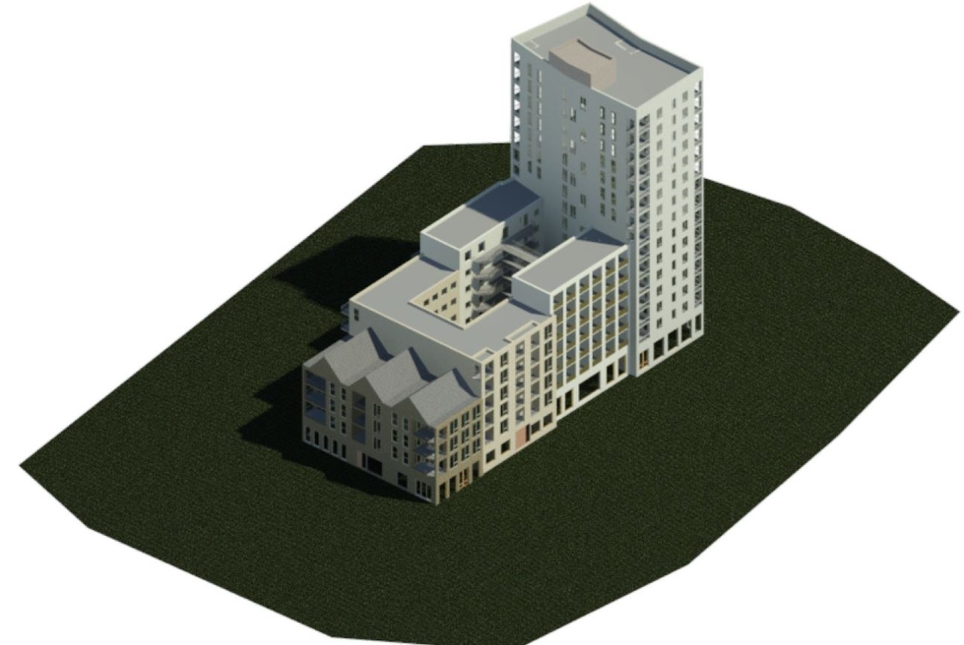
CAD TO BIM MODELLING SERVICES
REVIT
CAD TO BIM MODELLING SERVICES
HAND SKETCHES TO BIM MODELLING SERVICES
2D DOCUMENTATION SERVICES
BIM 4D SERVICES
ANIMATION & VISUALISATION SERVICES
BIM FACILITY MANAGEMENT SERVICES
MEP DESIGN SERVICES
2. SCAN TO BIM MODELLING SERVICES
3. GIS
4. BIM RESOURCE MANAGEMENT
Client: Preconvision
Project Name: Plot - 18 Project Type: Residential Location: UK LOD: 300 Area: 78,000 Sqmts
Software’s Used: AutoCAD, Revit, Naviswork
Scope of Work: ( Architectural & Structural Modelling)
LOD 300 model developed with the help of Design CAD files.
www.10four.org
Firm Portfolio|12

Slide 13
VILLAS
www.10four.org
Firm Portfolio|13

Slide 14
CAD TO BIM MODELLING SERVICES
REVIT
CAD TO BIM MODELLING SERVICES
HAND SKETCHES TO BIM MODELLING SERVICES
2D DOCUMENTATION SERVICES
BIM 4D SERVICES
ANIMATION & VISUALISATION SERVICES
BIM FACILITY MANAGEMENT SERVICES
MEP DESIGN SERVICES
2. SCAN TO BIM MODELLING SERVICES
3. GIS
4. BIM RESOURCE MANAGEMENT
Client: ECOXAX
Project Name: Al Bahar Villas
Project Type: Commercial Location: Abu Dhabi LOD: 400 Area: NA
Software’s Used: AutoCAD, Revit & Diroots
Scope of Work: ( MEP Modelling)
LOD 400 model developed with the help of Design CAD files. Schedules extracted from revit. Generated 2D Detail Design drawings.
www.10four.org
Firm Portfolio|14

Slide 15
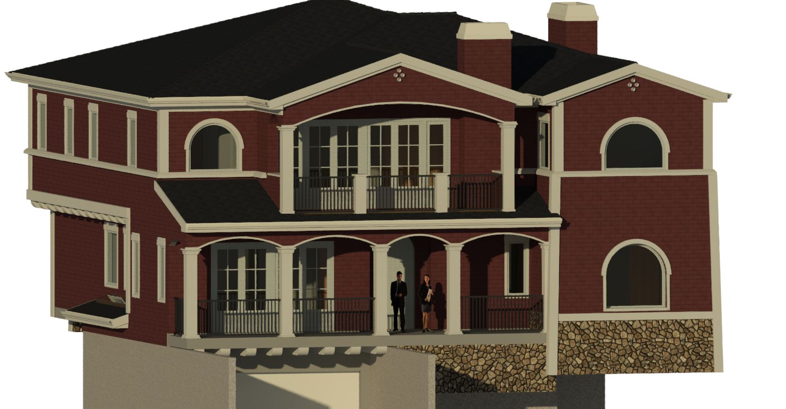
HAND SKETCHES TO BIM MODELLING SERVICES
REVIT
CAD TO BIM MODELLING SERVICES
HAND SKETCHES TO BIM MODELLING SERVICES
2D DOCUMENTATION SERVICES
BIM 4D SERVICES
ANIMATION & VISUALISATION SERVICES
BIM FACILITY MANAGEMENT SERVICES
MEP DESIGN SERVICES
2. SCAN TO BIM MODELLING SERVICES
3. GIS
4. BIM RESOURCE MANAGEMENT
Client: Joe Palka Architects
Project Name: Belton & Riche Project Type: Residential Location: United States LOD: 400 Area: 4,600 Sqmts ( More than 20 Villas)
Software’s Used: AutoCAD, Revit, Naviswork, BIM 360
Scope of Work: ( Architectural & Structural Modelling)
The client was from USA, we act as BIM Resource management for the architect team. Our role varies based on client requirement. We mostly support in BIM Modelling and Interior Detailing for Villa Projects.
www.10four.org
Firm Portfolio|15

Slide 16
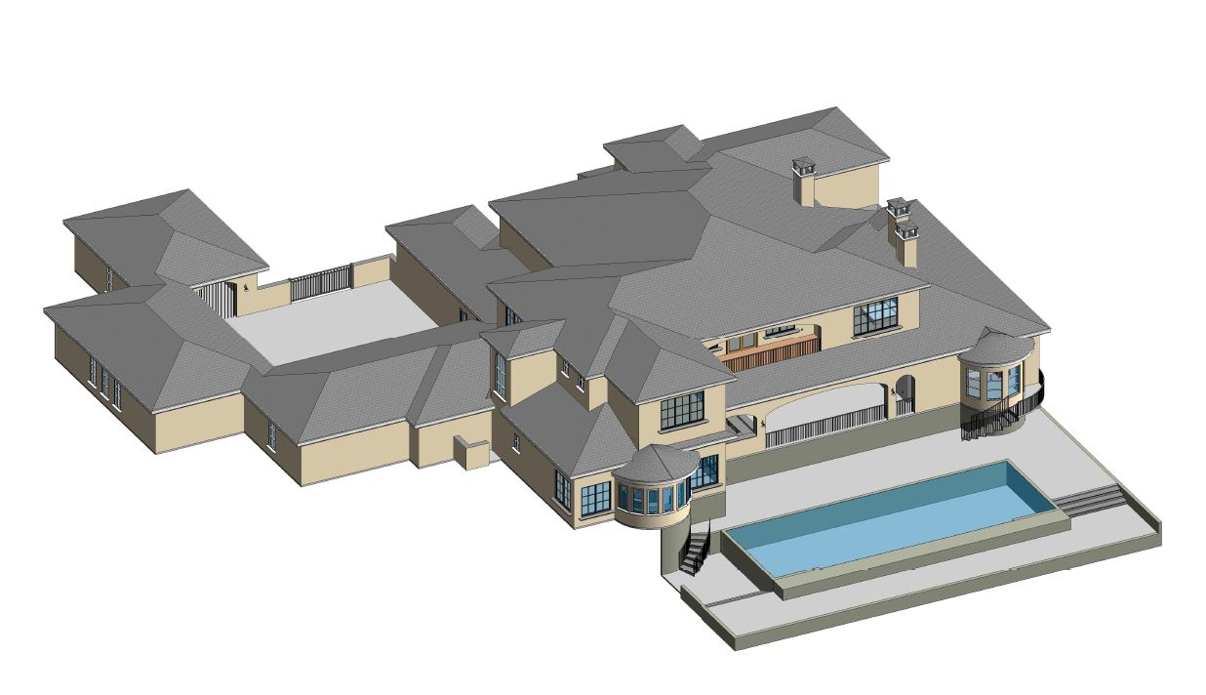
HAND SKETCHES TO BIM MODELLING SERVICES
REVIT
CAD TO BIM MODELLING SERVICES
HAND SKETCHES TO BIM MODELLING SERVICES
2D DOCUMENTATION SERVICES
BIM 4D SERVICES
ANIMATION & VISUALISATION SERVICES
BIM FACILITY MANAGEMENT SERVICES
MEP DESIGN SERVICES
2. SCAN TO BIM MODELLING SERVICES
3. GIS
4. BIM RESOURCE MANAGEMENT
Client: The BDX
Project Name: Mr. Smith 2 Project Type: Residential Location: United States LOD: 400 Area: 5,000 Sqmts
Software’s Used: AutoCAD, Revit, Naviswork, BIM 360 & Vision Ray
Scope of Work: ( Architectural, Structural & Electrical Modelling)
The client was from USA, we act as BIM Resource management for the architect team. Our role varies based on client requirement. We mostly support in BIM Modelling and Interior Detailing for Villa Projects.
www.10four.org
Firm Portfolio|16

Slide 17
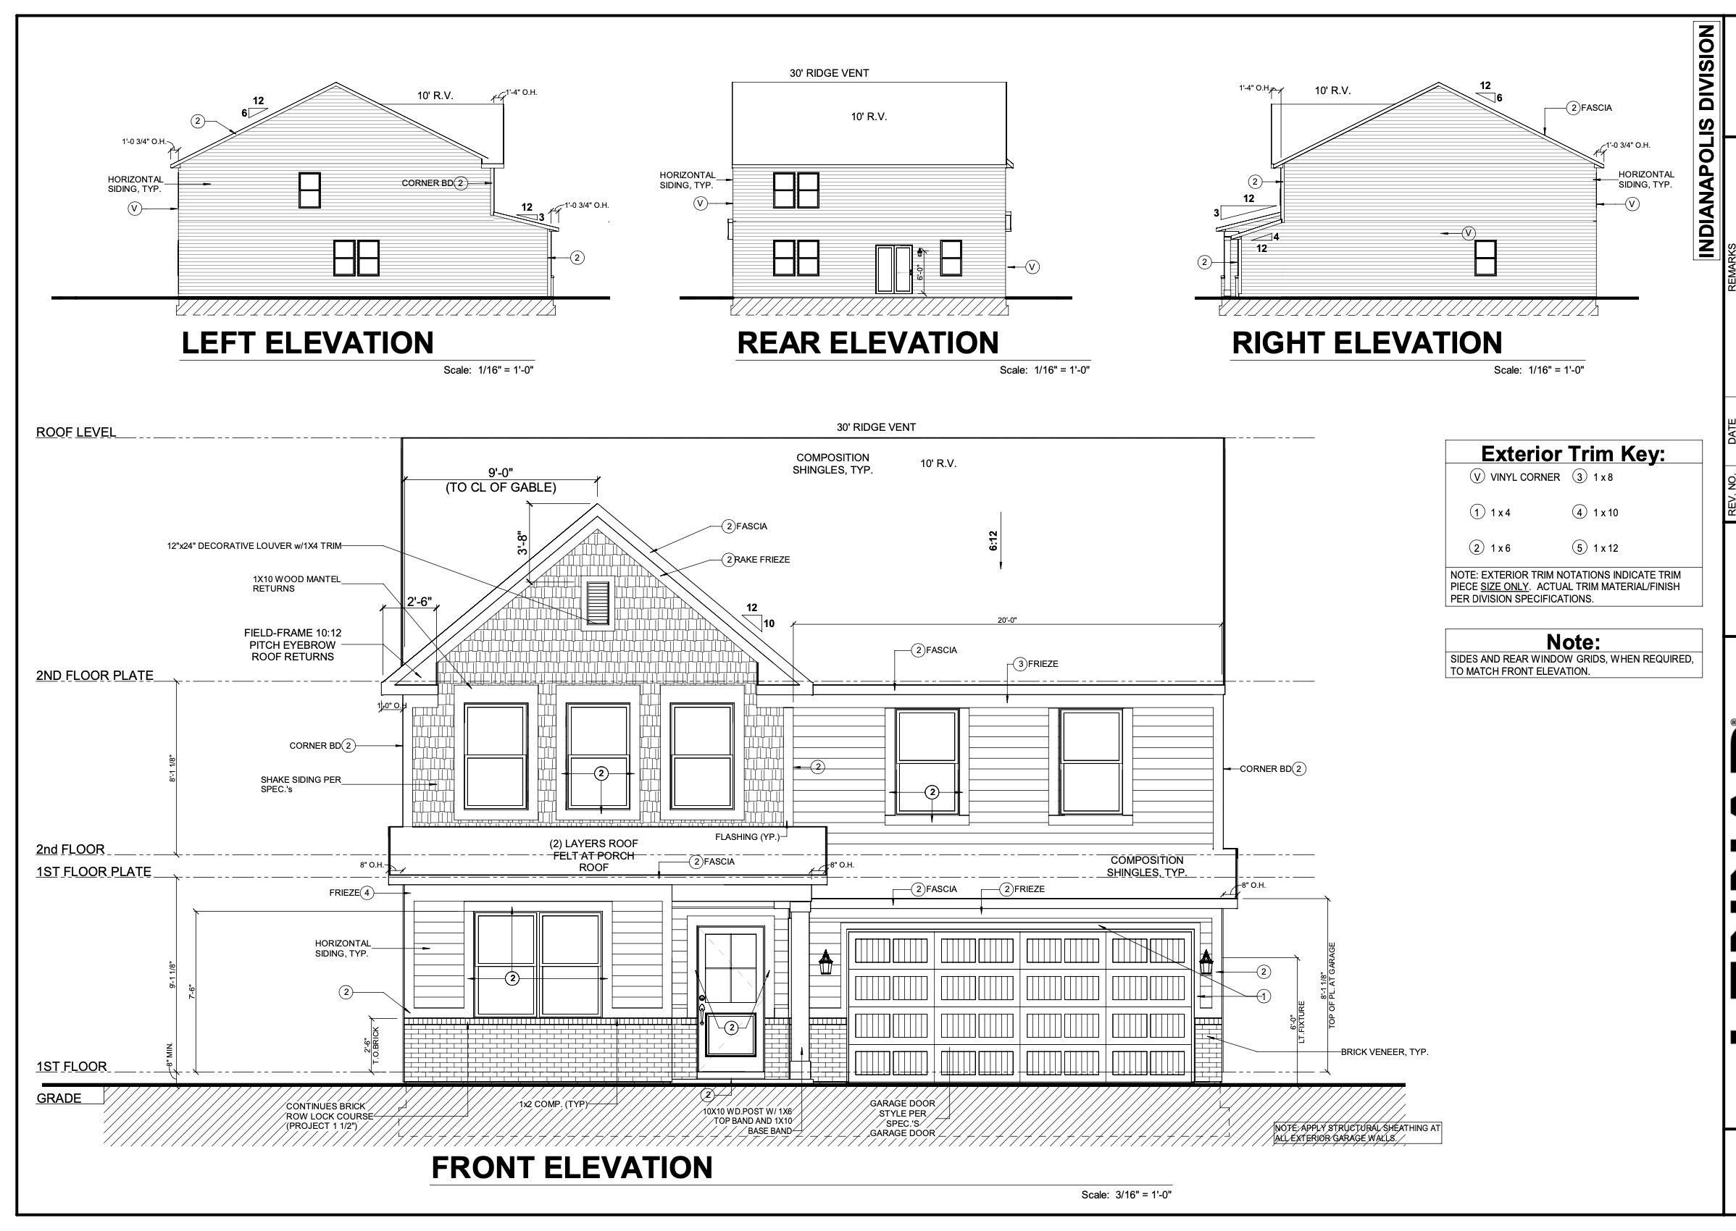
HAND SKETCHES TO BIM MODELLING SERVICES
REVIT
CAD TO BIM MODELLING SERVICES
HAND SKETCHES TO BIM MODELLING SERVICES
2D DOCUMENTATION SERVICES
BIM 4D SERVICES
ANIMATION & VISUALISATION SERVICES
BIM FACILITY MANAGEMENT SERVICES
MEP DESIGN SERVICES
2. SCAN TO BIM MODELLING SERVICES
3. GIS
4. BIM RESOURCE MANAGEMENT
Client: The BDX
Project Name: Valencia Project Type: Residential Location: United States LOD: 400 Area: 3,000 Sqmts
Software’s Used: AutoCAD, Revit, Naviswork, BIM 360 & Vision Ray
Scope of Work: ( Architectural, Structural & Electrical Modelling)
The client was from USA, we act as BIM Resource management for the architect team. Our role varies based on client requirement. We mostly support in BIM Modelling and Interior Detailing for Villa Projects.
www.10four.org
Firm Portfolio|17

Slide 18
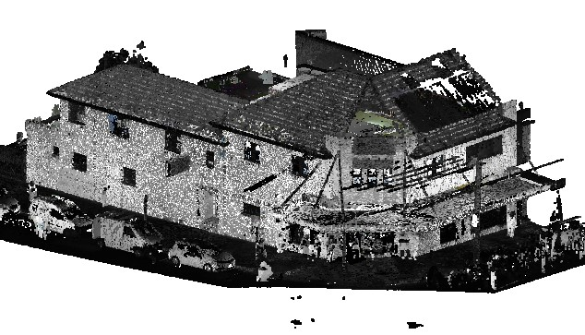
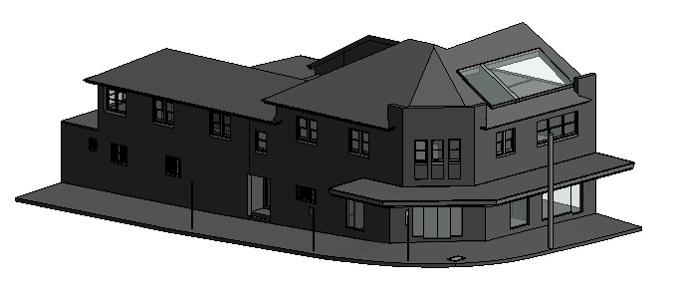
SCAN TO BIM MODELLING SERVICES
REVIT
CAD TO BIM MODELLING SERVICES
HAND SKETCHES TO BIM MODELLING SERVICES
2D DOCUMENTATION SERVICES
BIM 4D SERVICES
ANIMATION & VISUALISATION SERVICES
BIM FACILITY MANAGEMENT SERVICES
MEP DESIGN SERVICES
2. SCAN TO BIM MODELLING SERVICES
3. GIS
4. BIM RESOURCE MANAGEMENT
Client: Client - 17
Project Name: Project- 14 Project Type: Residential Location: Sweden LOD: 300 Area: NA
Software’s Used: Revit & Recap
Scope of Work: ( Architectural & Structural Modelling)
Client’s final requirement is to develop LOD 300 model with the help of Scan Data ( LIDAR Scan Data).
www.10four.org
Firm Portfolio|18

Slide 19
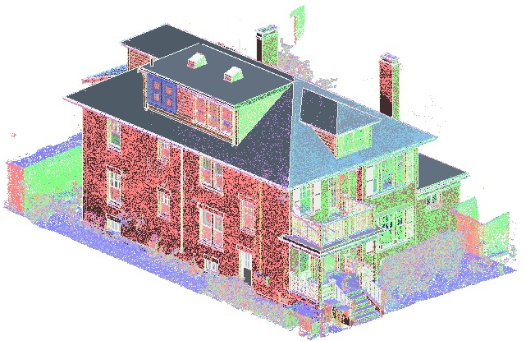
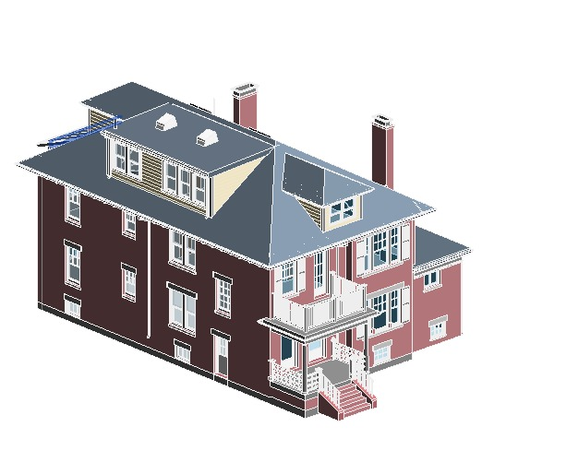
SCAN TO BIM MODELLING SERVICES
REVIT
CAD TO BIM MODELLING SERVICES
HAND SKETCHES TO BIM MODELLING SERVICES
2D DOCUMENTATION SERVICES
BIM 4D SERVICES
ANIMATION & VISUALISATION SERVICES
BIM FACILITY MANAGEMENT SERVICES
MEP DESIGN SERVICES
2. SCAN TO BIM MODELLING SERVICES
3. GIS
4. BIM RESOURCE MANAGEMENT
Client: Client - 17
Project Name: 69 Reservoir Street Project Type: Residential Location: UK LOD: 300 Area: NA
Software’s Used: Revit & Recap
Scope of Work: ( Architectural & Structural Modelling)
Client’s final requirement is to develop LOD 300 model with the help of Scan Data ( LIDAR Scan Data).
www.10four.org
Firm Portfolio|19

Slide 20
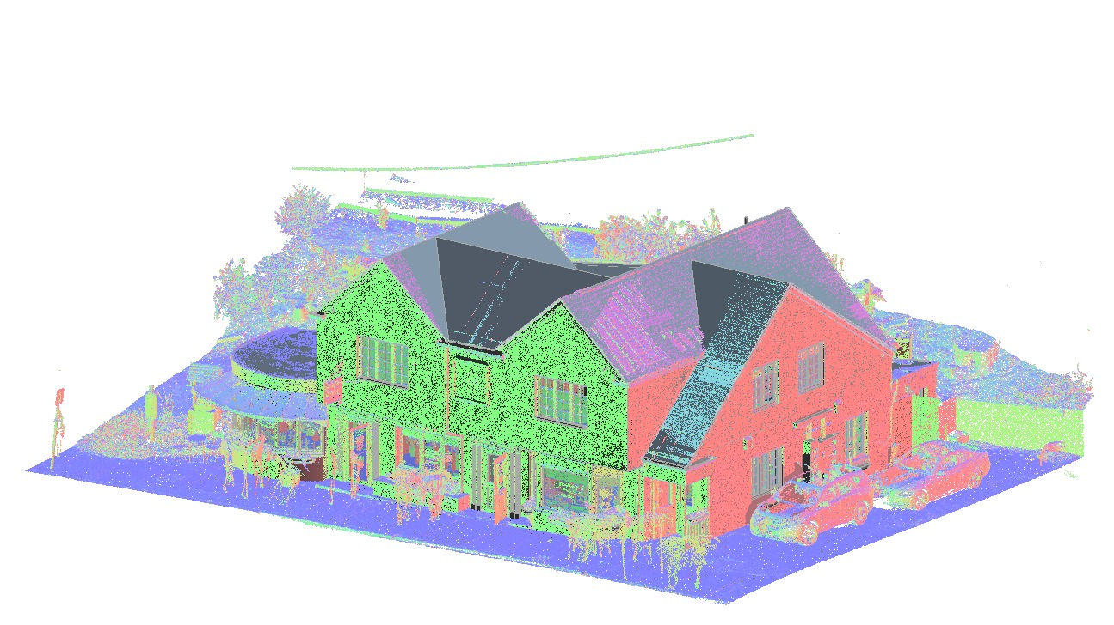
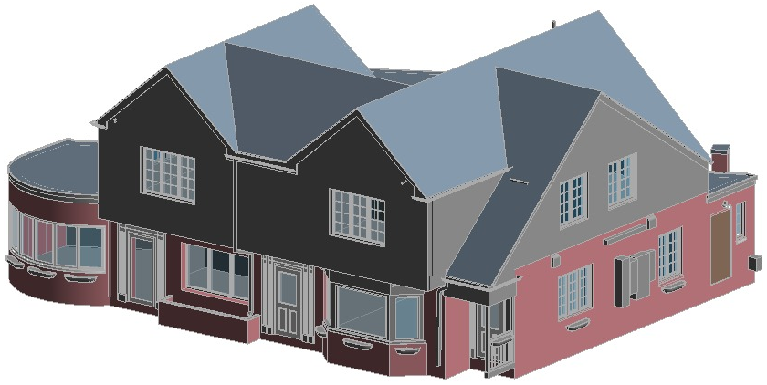
SCAN TO BIM MODELLING SERVICES
REVIT
CAD TO BIM MODELLING SERVICES
HAND SKETCHES TO BIM MODELLING SERVICES
2D DOCUMENTATION SERVICES
BIM 4D SERVICES
ANIMATION & VISUALISATION SERVICES
BIM FACILITY MANAGEMENT SERVICES
MEP DESIGN SERVICES
2. SCAN TO BIM MODELLING SERVICES
3. GIS
4. BIM RESOURCE MANAGEMENT
Client: Client - 17
Project Name: Project- 13 Project Type: Residential Location: Sweden LOD: 300 Area: NA
Software’s Used: Revit & Recap
Scope of Work: ( Architectural & Structural Modelling)
Client’s final requirement is to develop LOD 300 model with the help of Scan Data ( LIDAR Scan Data).
www.10four.org
Firm Portfolio|20

Slide 21
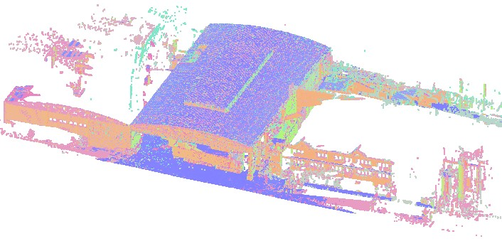
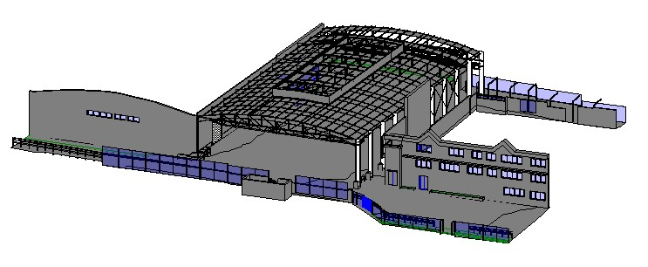
SCAN TO BIM MODELLING SERVICES
REVIT
CAD TO BIM MODELLING SERVICES
HAND SKETCHES TO BIM MODELLING SERVICES
2D DOCUMENTATION SERVICES
BIM 4D SERVICES
ANIMATION & VISUALISATION SERVICES
BIM FACILITY MANAGEMENT SERVICES
MEP DESIGN SERVICES
2. SCAN TO BIM MODELLING SERVICES
3. GIS
4. BIM RESOURCE MANAGEMENT
Client: Client - 17
Project Name: Project- 15 Project Type: Commercial Location: US LOD: 300 Area: NA
Software’s Used: Revit & Recap
Scope of Work: ( Architectural & Structural Modelling)
Client’s final requirement is to develop LOD 300 model with the help of Scan Data ( LIDAR Scan Data).
www.10four.org
Firm Portfolio|21

Slide 22
METROS & AIRPORTS
www.10four.org
Firm Portfolio|22

Slide 23
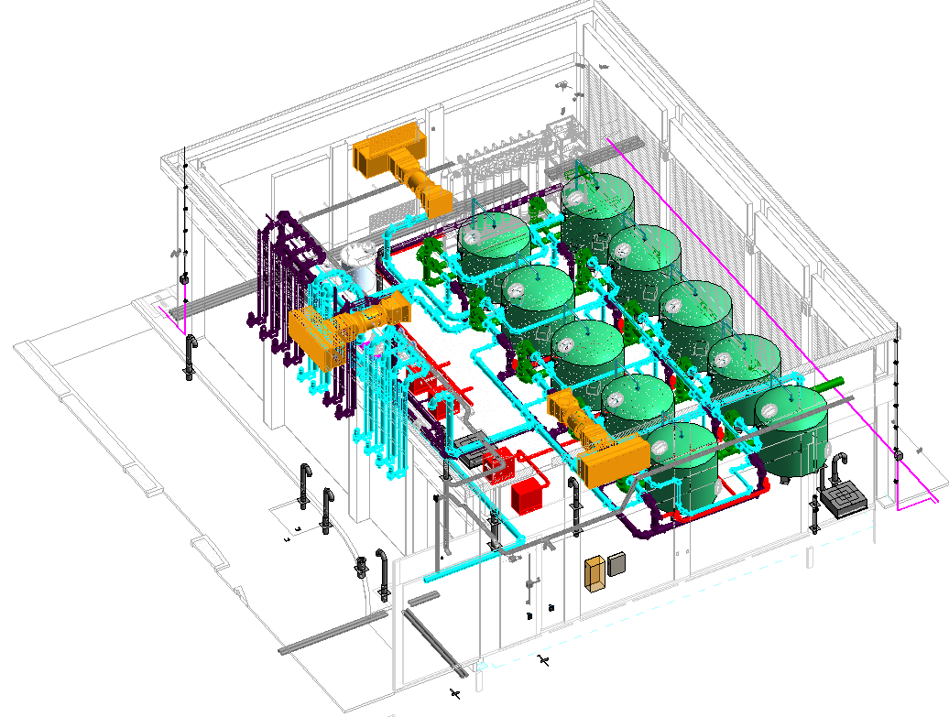
CAD TO BIM MODELLING SERVICES
REVIT
CAD TO BIM MODELLING SERVICES
HAND SKETCHES TO BIM MODELLING SERVICES
2D DOCUMENTATION SERVICES
BIM 4D SERVICES
ANIMATION & VISUALISATION SERVICES
BIM FACILITY MANAGEMENT SERVICES
MEP DESIGN SERVICES
2. SCAN TO BIM MODELLING SERVICES
3. GIS
4. BIM RESOURCE MANAGEMENT
Client: Prism
Project Name: Yamuna International Airport Project Type: AirPort Location: Noida, India LOD: 300 Area: -
Software’s Used: AutoCad & Revit
Scope of Work: (MEP Modelling )
LOD 300 model developed with the help of Design CAD files .
www.10four.org
Firm Portfolio|23

Slide 24
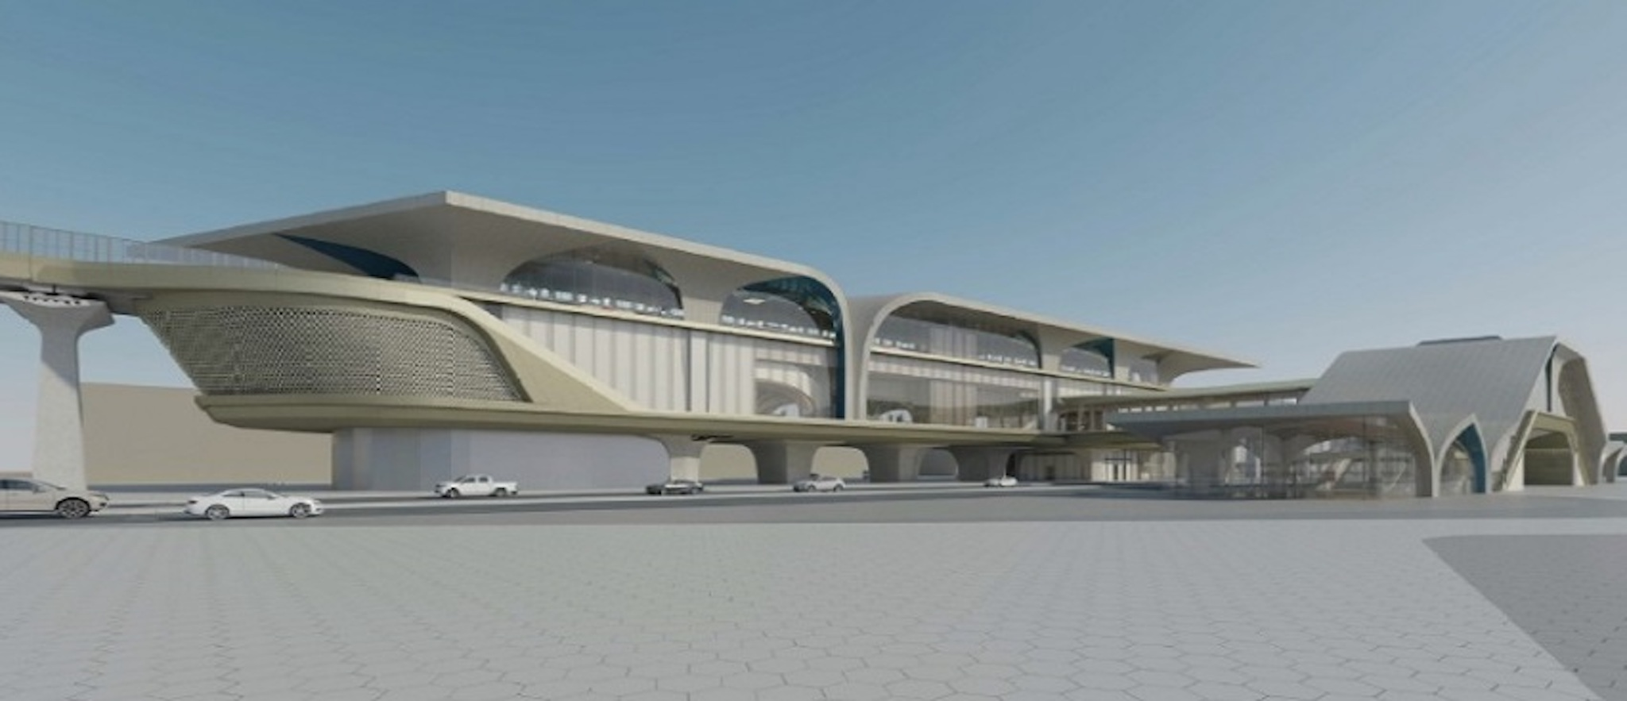
CAD TO BIM MODELLING SERVICES
REVIT
CAD TO BIM MODELLING SERVICES
HAND SKETCHES TO BIM MODELLING SERVICES
2D DOCUMENTATION SERVICES
BIM 4D SERVICES
ANIMATION & VISUALISATION SERVICES
BIM FACILITY MANAGEMENT SERVICES
MEP DESIGN SERVICES
2. SCAN TO BIM MODELLING SERVICES
3. GIS
4. BIM RESOURCE MANAGEMENT
Client: Client 1
Project Name: National Libray Of Qatar Metro Station Project Type: Metro Location: Qatar LOD: 300 Area: -
Software’s Used: AutoCad & Revit
Scope of Work: (MEP Modelling )
LOD 300 model developed with the help of Design CAD files .
www.10four.org
Firm Portfolio|24

Slide 25
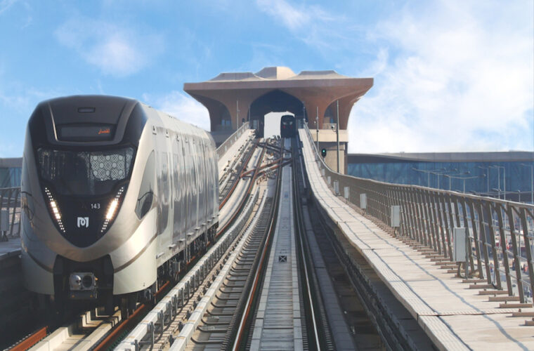
CAD TO BIM MODELLING SERVICES
REVIT
CAD TO BIM MODELLING SERVICES
HAND SKETCHES TO BIM MODELLING SERVICES
2D DOCUMENTATION SERVICES
BIM 4D SERVICES
ANIMATION & VISUALISATION SERVICES
BIM FACILITY MANAGEMENT SERVICES
MEP DESIGN SERVICES
2. SCAN TO BIM MODELLING SERVICES
3. GIS
4. BIM RESOURCE MANAGEMENT
Client: Client 2
Project Name: Hammad Hospital Metro Station Project Type: Metro Location: Qatar LOD: 300 Area: -
Software’s Used: AutoCad & Revit
Scope of Work: (MEP Modelling )
LOD 300 model developed with the help of Design CAD files .
www.10four.org
Firm Portfolio|25

Slide 26
INDUSTRIAL
www.10four.org
Firm Portfolio126

Slide 27
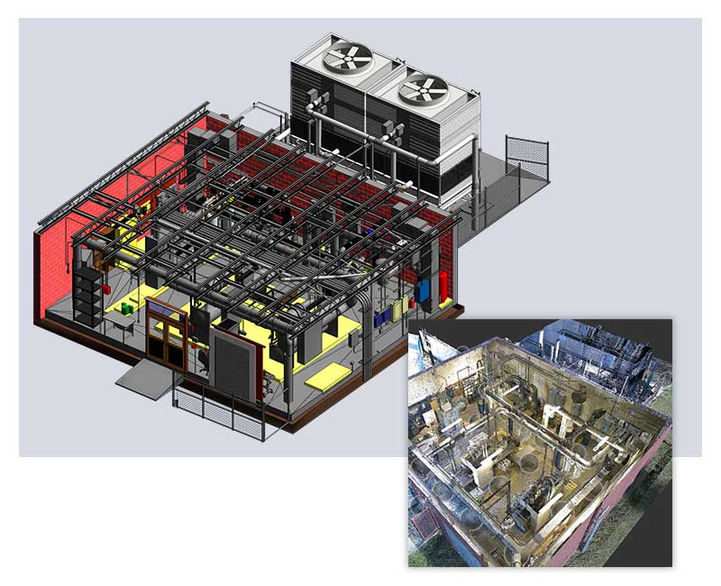
SCAN TO BIM MODELLING SERVICES
REVIT
CAD TO BIM MODELLING SERVICES
HAND SKETCHES TO BIM MODELLING SERVICES
2D DOCUMENTATION SERVICES
BIM 4D SERVICES
ANIMATION & VISUALISATION SERVICES
BIM FACILITY MANAGEMENT SERVICES
2. SCAN TO BIM MODELLING SERVICES
3. GIS
4. BIM RESOURCE MANAGEMENT
Client: Virtual Building Studios
Project Name: MEP Project-1 Project Type: Industrial Location: Brazil LOD: 300 Area: 12,500 Sqmts
Software’s Used: AutoCAD, Revit, Naviswork
Scope of Work: (MEPF Modelling )
Client is from Brazil, LOD 300 model developed with the help of Lidar Scan files. It’s a Pharma industry. Created basic families.
www.10four.org
Firm Portfolio127

Slide 28
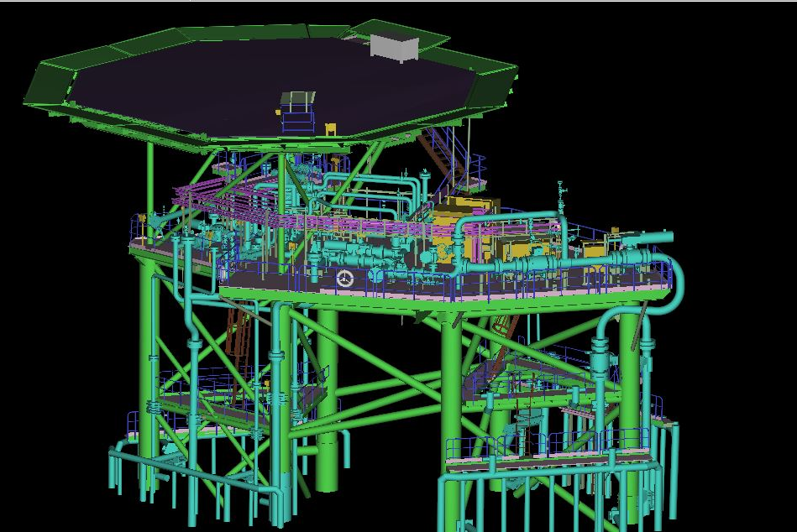
SCAN TO BIM MODELLING SERVICES
REVIT
CAD TO BIM MODELLING SERVICES
HAND SKETCHES TO BIM MODELLING SERVICES
2D DOCUMENTATION SERVICES
BIM 4D SERVICES
ANIMATION & VISUALISATION SERVICES
BIM FACILITY MANAGEMENT SERVICES
2. SCAN TO BIM MODELLING SERVICES
3. GIS
4. BIM RESOURCE MANAGEMENT
Client: Client-3
Project Name: US Rig-19 Project Type: Industrial Location: US LOD: 300 ( Modelling ) Area: NA Software’s Used: Cyclone, Revit & Recap
Scope of Work: (Architectural, Structural, MEPF Modelling)
Client’s final requirement is to develop LOD 300 model with the help of Scan Data ( LIDAR Scan Data).
www.10four.org
Firm Portfolio128

Slide 29
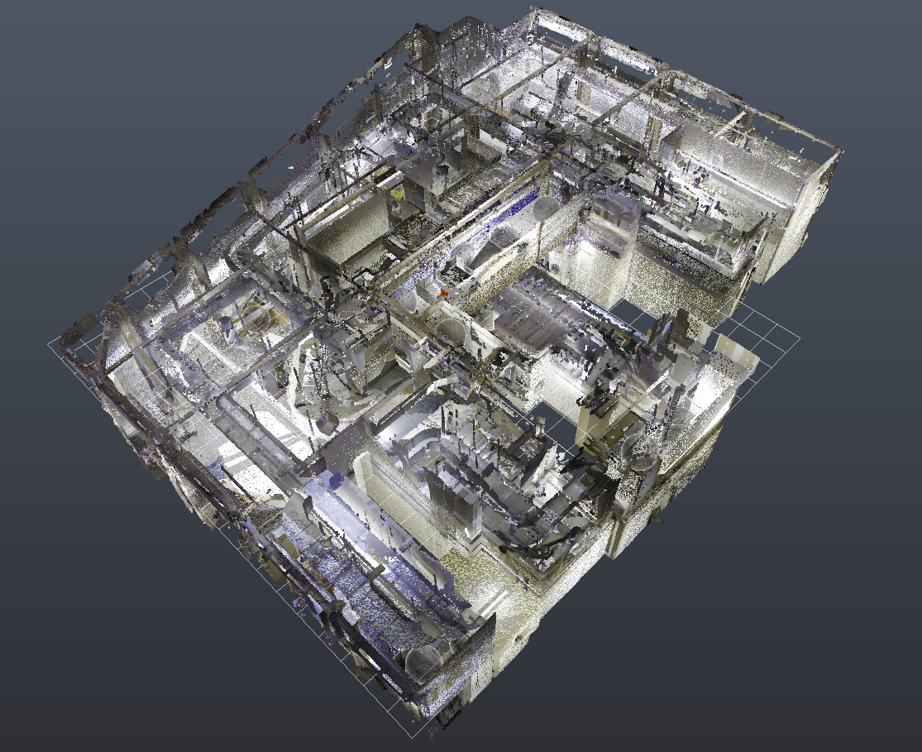
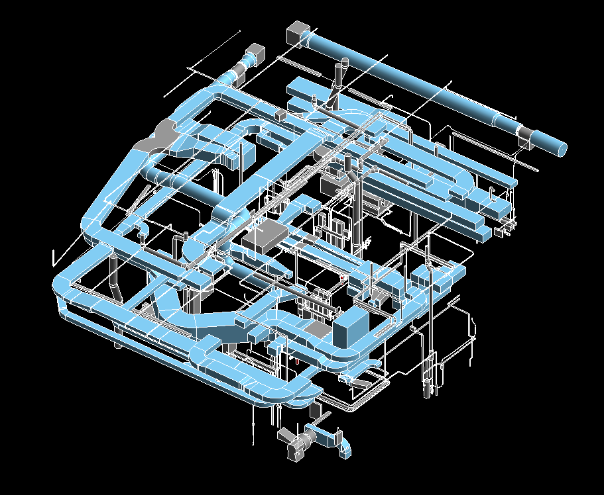
SCAN TO BIM MODELLING SERVICES
REVIT
CAD TO BIM MODELLING SERVICES
HAND SKETCHES TO BIM MODELLING SERVICES
2D DOCUMENTATION SERVICES
BIM 4D SERVICES
ANIMATION & VISUALISATION SERVICES
BIM FACILITY MANAGEMENT SERVICES
2. SCAN TO BIM MODELLING SERVICES
3. GIS
4. BIM RESOURCE MANAGEMENT
Client: Virtual Building Studios
Project Name: Project-1 Project Type: Medical Industry Location: Brazil LOD: 300 Area: 12,500 Sqmts
Software’s Used: Revit & Recap
Scope of Work: ( MEP Modelling )
Client is from Brazil, LOD 300 model developed with the help of Lidar Scan files. It’s a Pharma industry. Created basic families.
www.10four.org
Firm Portfolio129

Slide 30
INFRA STRUCTURE
www.10four.org
Firm Portfolio130

Slide 31
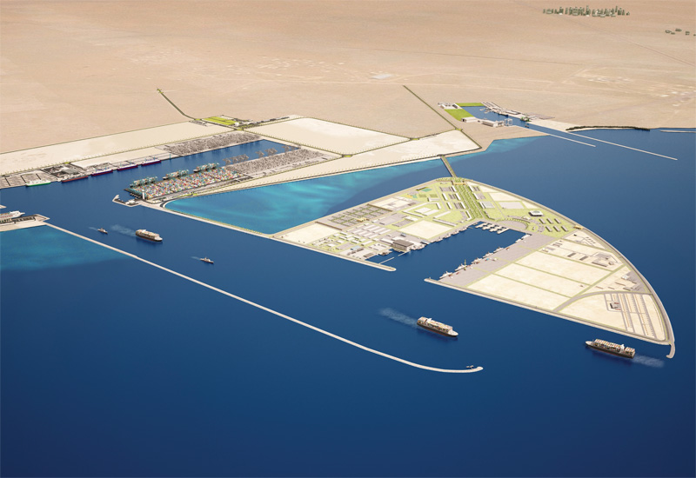
CAD TO BIM MODELLING SERVICES
REVIT
CAD TO BIM MODELLING SERVICES
HAND SKETCHES TO BIM MODELLING SERVICES
2D DOCUMENTATION SERVICES
BIM 4D SERVICES
ANIMATION & VISUALISATION SERVICES
BIM FACILITY MANAGEMENT SERVICES
MEP DESIGN SERVICES
2. SCAN TO BIM MODELLING SERVICES
3. GIS
4. BIM RESOURCE MANAGEMENT
Client: Geoshot Technologies
Project Name: Qatar New Port Project Type: Infrastructure Location: Qatar LOD: 300 Area: NA
Software’s Used: AutoCAD, Revit, Naviswork
Scope of Work: ( Architectural & Structural Modelling)
LOD 300 model developed with the help of Design CAD files. Schedules extracted from Revit and generated 2D Detail Design drawings.
www.10four.org
Firm Portfolio|31

Slide 32
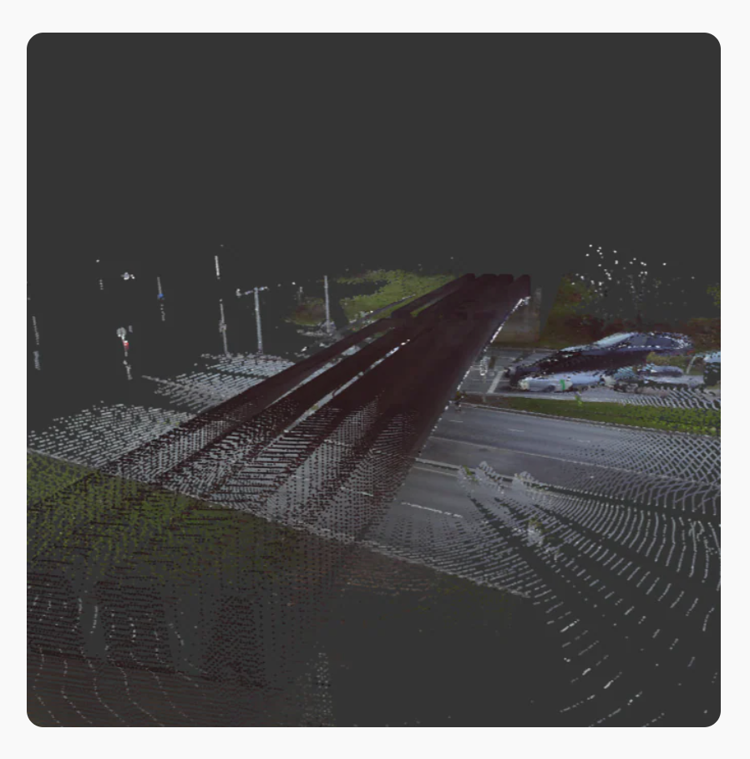
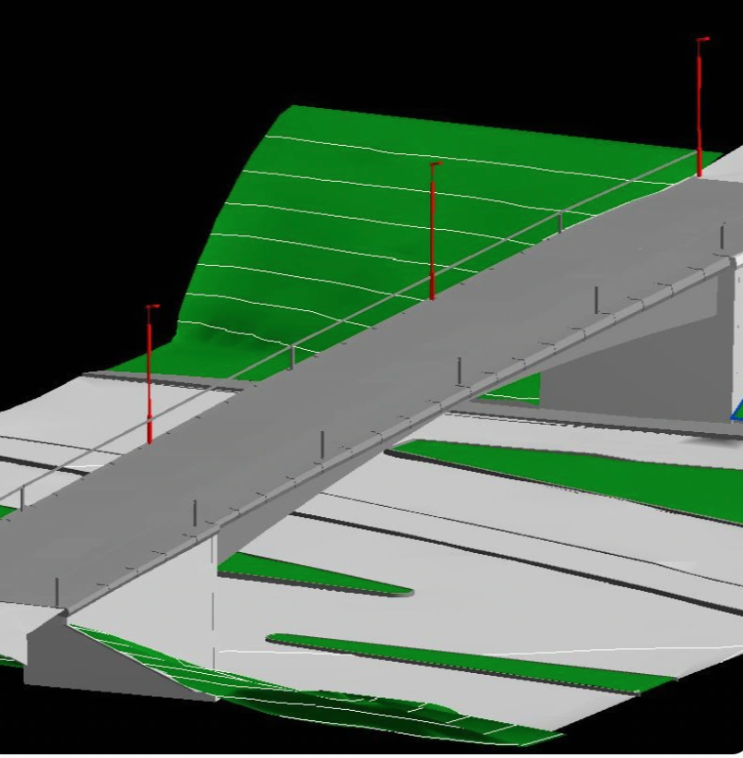
SCAN TO BIM MODELLING SERVICES
REVIT
CAD TO BIM MODELLING SERVICES
HAND SKETCHES TO BIM MODELLING SERVICES
2D DOCUMENTATION SERVICES
BIM 4D SERVICES
ANIMATION & VISUALISATION SERVICES
BIM FACILITY MANAGEMENT SERVICES
2. SCAN TO BIM MODELLING SERVICES
3. GIS
4. BIM RESOURCE MANAGEMENT
Client: VK BIM Solutions
Project Name: UK Bridges Project Type: Infrastructure Location: UK LOD: 300 Area: N/A
Software’s Used: AutoCAD, Revit, Naviswork
Scope of Work: (Bridge Modelling )
Client is from UK, LOD 300 model developed with the help of Lidar Scan files. Nearly 20 Bridges has been modelled
www.10four.org
Firm Portfolio|32

Slide 33
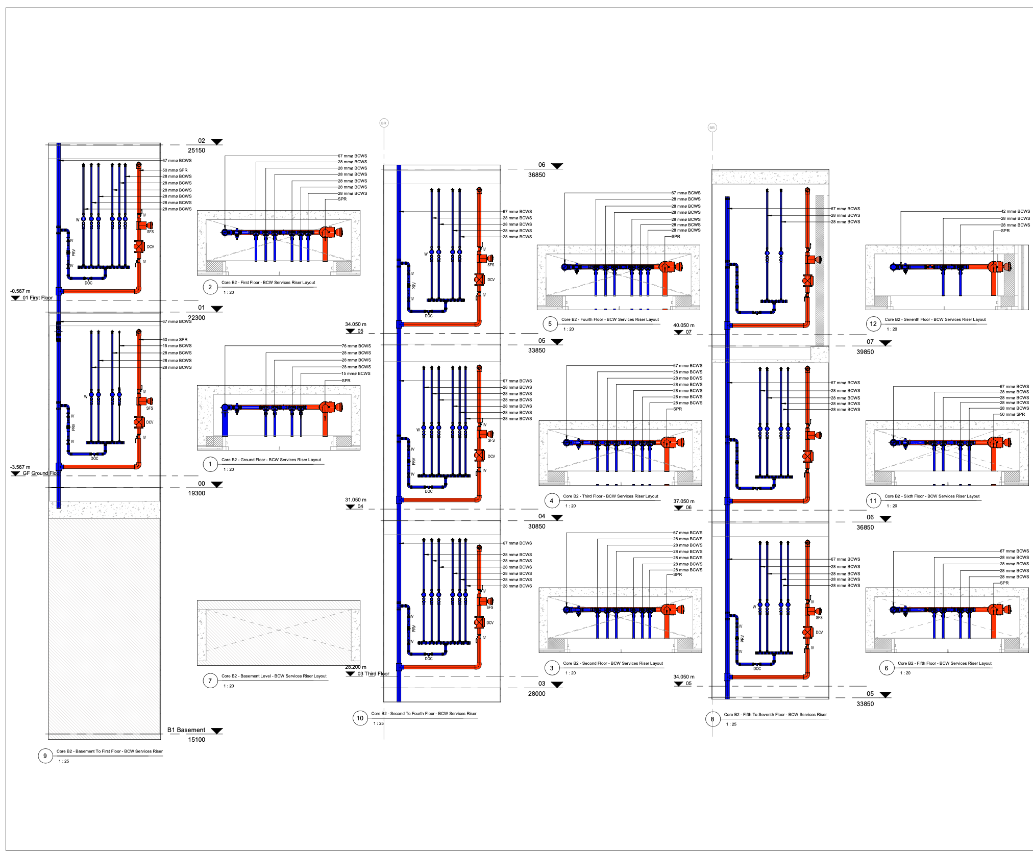
2D DOCUMENTATION SERVICES
REVIT
CAD TO BIM MODELLING SERVICES
HAND SKETCHES TO BIM MODELLING SERVICES
2D DOCUMENTATION SERVICES
BIM 4D SERVICES
ANIMATION & VISUALISATION SERVICES
BIM FACILITY MANAGEMENT SERVICES
MEP DESIGN SERVICES
2. SCAN TO BIM MODELLING SERVICES
3. GIS
4. BIM RESOURCE MANAGEMENT
Client: EDC Consultants
Project Name: Thornton Park Residential Buildings Project Type: Residential Location: Ireland LOD: 300 Area: 90,00 Sqmts
Software’s Used: AutoCAD, Revit, Naviswork & BIM 360
Scope of Work: ( MEPF Modelling)
The project consists of A,B,C Blocks, our scope is MEP modelling at LOD 300 with hand sketches Design drawings, Our scope also includes coordination and generating coordination drawings.
www.10four.org
Firm Portfolio|33

Slide 34
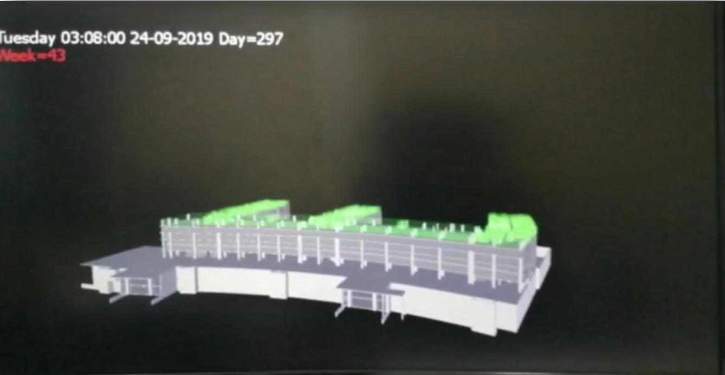
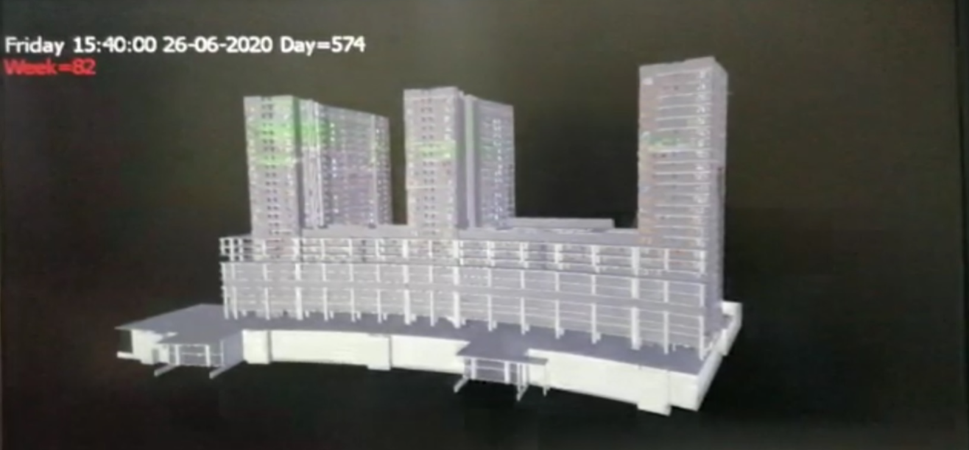
BIM 4D SERVICES
REVIT
CAD TO BIM MODELLING SERVICES
HAND SKETCHES TO BIM MODELLING SERVICES
2D DOCUMENTATION SERVICES
BIM 4D SERVICES
ANIMATION & VISUALISATION SERVICES
BIM FACILITY MANAGEMENT SERVICES
MEP DESIGN SERVICES
2. SCAN TO BIM MODELLING SERVICES
3. GIS
4. BIM RESOURCE MANAGEMENT
Client: Xtolec offshore
Project Name: Dubai Hills Project Type: Residential Location: Dubai LOD: 300 Area: 1,25,00 Sqmts
Software’s Used: Naviswork
Scope of Work: ( 4D Sequence)
Received 3D model and MS-Project data from the client and provided complete timeline of the construction in Naviswork and construction support to the client by delivering actual vs planned dates.
www.10four.org
Firm Portfolio|34

Slide 35
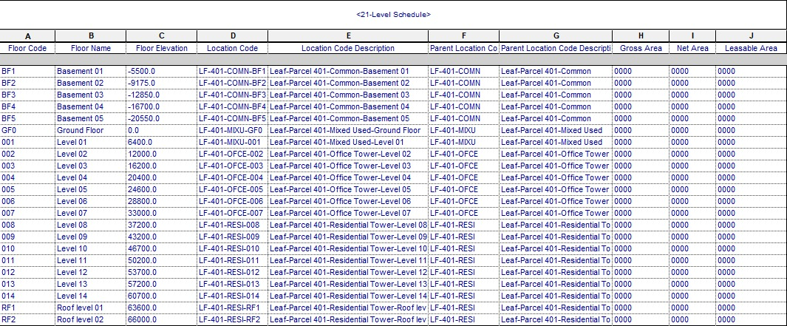
BIM FACILITY MANAGEMENT SERVICES
REVIT
CAD TO BIM MODELLING SERVICES
HAND SKETCHES TO BIM MODELLING SERVICES
2D DOCUMENTATION SERVICES
BIM 4D SERVICES
ANIMATION & VISUALISATION SERVICES
BIM FACILITY MANAGEMENT SERVICES
2. SCAN TO BIM MODELLING SERVICES
3. GIS
4. BIM RESOURCE MANAGEMENT
Client: KAFD
Project Name: King Abdullah Financial District – Parcel 4.01 Project Type: Residential & Commercial Location: Saudi Arabia LOD: 300 ( Modelling ) & 500 ( Facility Management) Area: 33,000 Sqmts Software’s Used: AutoCAD, Revit, Naviswork, Recap, Diroots & COBIE
Scope of Work: (facility Management)
Client’s final requirement is Facility management, the LOD 300 model developed with the help of CAD files and Scan Data ( LIDAR Scan Data). Complete data was updated as per Asset Register collected from all stack holders. Schedules extracted from Revit and generated 2D As-built drawings.
www.10four.org
Firm Portfolio|36

Slide 36
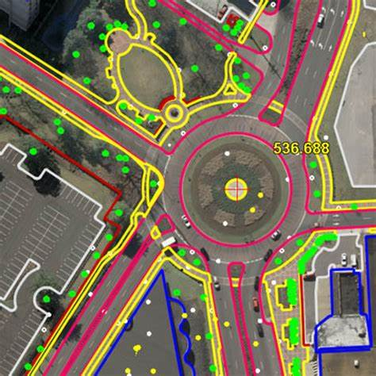
GIS
REVIT
CAD TO BIM MODELLING SERVICES
HAND SKETCHES TO BIM MODELLING SERVICES
2D DOCUMENTATION SERVICES
BIM 4D SERVICES
ANIMATION & VISUALISATION SERVICES
BIM FACILITY MANAGEMENT SERVICES
2. SCAN TO BIM MODELLING SERVICES
3. GIS
4. BIM RESOURCE MANAGEMENT
Client: Client – 1
Location: Brazil Area: NA Software’s Used: AutoCAD, Google Earth
Scope of Work:
Client’s requirement is to map road lines, Dividers & Foot paths.
www.10four.org
Firm Portfolio|37

Slide 37
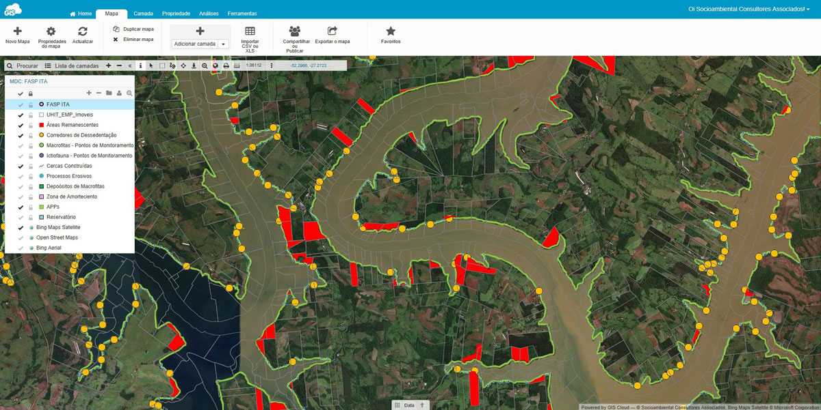
GIS
REVIT
CAD TO BIM MODELLING SERVICES
HAND SKETCHES TO BIM MODELLING SERVICES
2D DOCUMENTATION SERVICES
BIM 4D SERVICES
ANIMATION & VISUALISATION SERVICES
BIM FACILITY MANAGEMENT SERVICES
2. SCAN TO BIM MODELLING SERVICES
3. GIS
4. BIM RESOURCE MANAGEMENT
Client: Client – 1
Location: Brazil Area: NA Software’s Used: AutoCAD, Google Earth
Scope of Work:
Client’s requirement is to map rivers
www.10four.org
Firm Portfolio|38

Slide 38
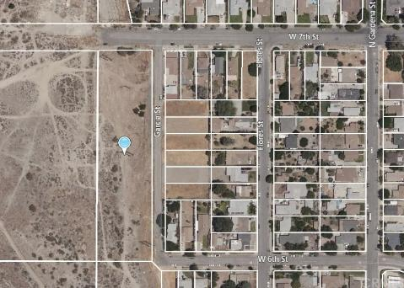
GIS
REVIT
CAD TO BIM MODELLING SERVICES
HAND SKETCHES TO BIM MODELLING SERVICES
2D DOCUMENTATION SERVICES
BIM 4D SERVICES
ANIMATION & VISUALISATION SERVICES
BIM FACILITY MANAGEMENT SERVICES
2. SCAN TO BIM MODELLING SERVICES
3. GIS
4. BIM RESOURCE MANAGEMENT
Client: Client – 2
Location: Brazil Area: NA Software’s Used: AutoCAD, Google Earth
Scope of Work:
Client’s requirement is to map empty plots
www.10four.org
Firm Portfolio|39

Slide 39
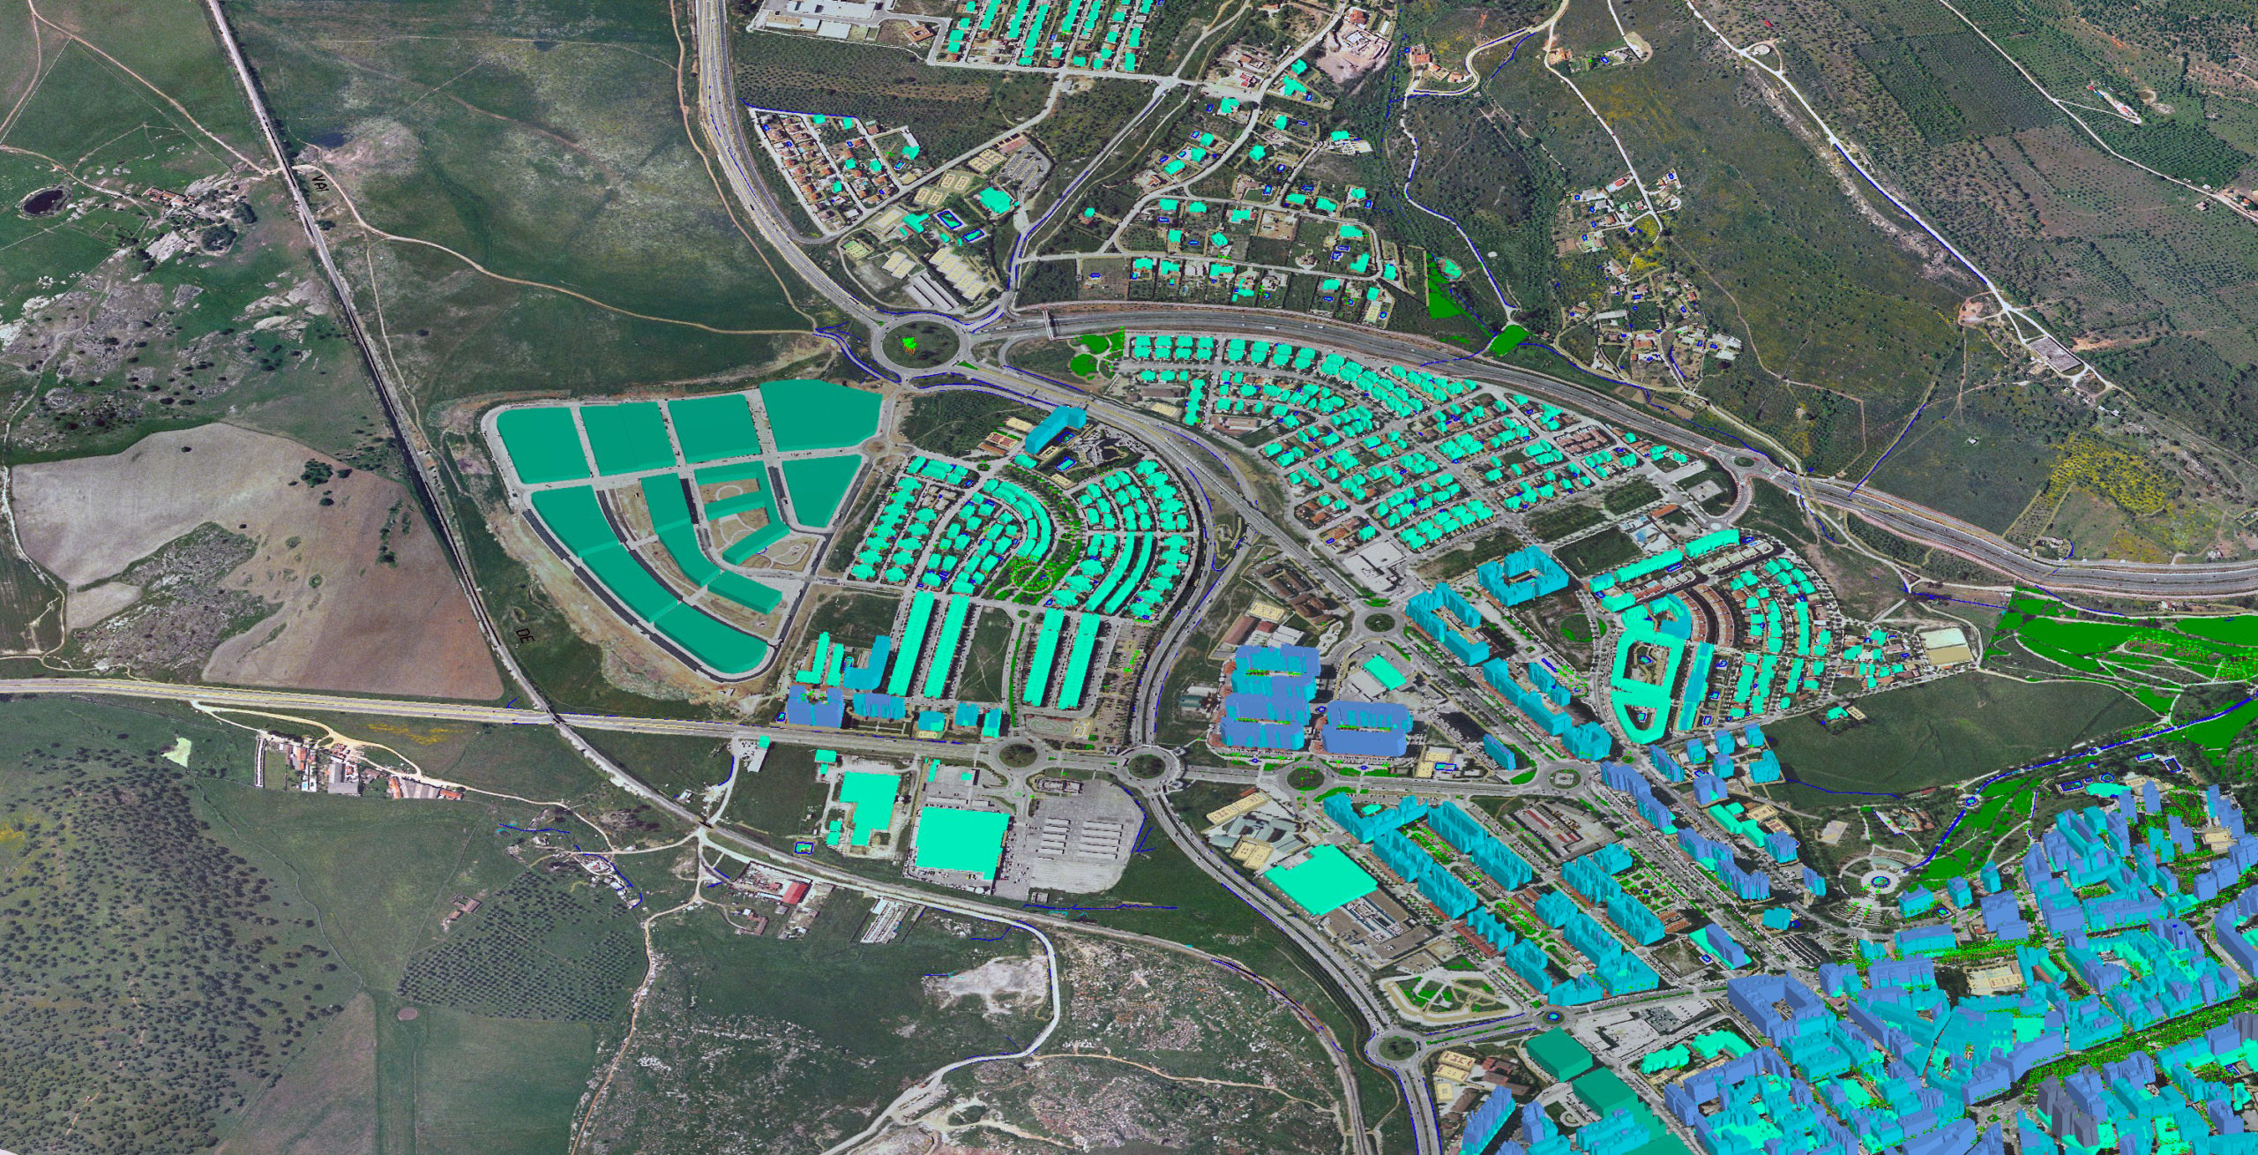
GIS
REVIT
CAD TO BIM MODELLING SERVICES
HAND SKETCHES TO BIM MODELLING SERVICES
2D DOCUMENTATION SERVICES
BIM 4D SERVICES
ANIMATION & VISUALISATION SERVICES
BIM FACILITY MANAGEMENT SERVICES
2. SCAN TO BIM MODELLING SERVICES
3. GIS
4. BIM RESOURCE MANAGEMENT
Client: Client – 3
Location: Brazil Area: NA Software’s Used: AutoCAD, Google Earth
Scope of Work:
Client’s requirement is to map buildings, plants
www.10four.org
Firm Portfolio|40

Slide 40
OUR RESPONSE:
We believe in responding to the immediate demands and needs of employers and that is why a lot of clients come to us to fulfil their needs for manpower. Whether it is design and site engineers, modelers and draft-mans in the field of construction. We believe in supplying the best manpower in all areas of our service. No matter if the requirement is for small residential or for larger projects we have the required manpower that is trained and skilled. We supply manpower on temporary as well as long term basis.
BIM
RESOURCE MANAGEMENT
Together with our associate companies we also supply manpower on short term as well as long term basis. Our manpower supply includes all categories of staff and workmen that are required for all services in residential as well as all commercial establishments including offices and High rise, Residential & Restaurants, hotels, Metro stations & mixed-use development projects around the world.
We also take into consideration the urgent needs of clients and always respond positively. We believe in supplying manpower that is efficient whether they are required for skilled or unskilled responsibilities. As a leading manpower service provider, we provide professionals who have the language skills to carry out works as instructed.
MANPOWER FOR A HOST OF ENGINEERING SERVICES:
DESIGN ENGINEERS REVIT MODELERS DRAFTS MAN
Architectural Architectural Architectural
Structural Structural Structural
Mechanical Mechanical Mechanical
Electrical Electrical Electrical
Plumbing Plumbing Plumbing
MEP coordinators MEP coordinators MEP coordinators
REVIT
CAD TO BIM MODELLING SERVICES
HAND SKETCHES TO BIM MODELLING SERVICES
2D DOCUMENTATION SERVICES
BIM 4D SERVICES
ANIMATION & VISUALISATION SERVICES
BIM FACILITY MANAGEMENT SERVICES
2. SCAN TO BIM MODELLING SERVICES
3. GIS
4. BIM RESOURCE MANAGEMENT
www.10four.org
Firm Portfolio|41

Slide 41
OUR LOCATIONS
USA Office:
9841 Washingtonian Blvd, Suite 200
Gaithersburg, Maryland 20878
United States
Contact Person:
Chetan Nain (CEO)
nain@10four.org
+1703980 7954
Rohan Tote ( Business Development Director)
rohan@10four.org
www.10four.org
Firm Portfolio|42

